Slide 1




2025-2026
ASSESSMENT READY
MAST FOR EDUCATORS
1
opi.mt.gov

Slide 2

MAST TESTING TASKS
MAST Testing Tasks | Slides
MAST Overview | 4-12
The Kite Educator Portal & MAST Training | 13-22
Schedule Testlets | 23-34
Verify Student Rosters and PNPs | 35-42
Print Student Tickets & Daily Access Codes (DACs) | 43-47
Prepare Students to Test | 48-56
2

Slide 3
MAST TESTING TASKS (CONT.)
Module | Slides
Administer Testlets | 57-63
Monitor Testlet Completion | 64-68
Access & Share Student Score Reports | 69-95
Reflect on successes and challenges of administration | 96-98
3

Slide 4
MAST OVERVIEW
  Identify key goals of MAST
  Understand the initial development timeline of MAST
  Understand the organization of MAST testlets
  Compare and contrast math and ELA testlets
4

Slide 5

MAST OVERVIEW
What is MAST?
  General population ELA and math assessment
  Grades 3-8
  Features a series of short, standards-aligned math and ELA tests (testlets) administered throughout the year
  Provides timely and relevant feedback for teachers and students, as well as comparable summative data for education leaders and federal accountability
  This “classroom up” approach provides flexible opportunities for students to demonstrate learning while providing actionable data to stakeholders throughout the education system
5

Slide 6
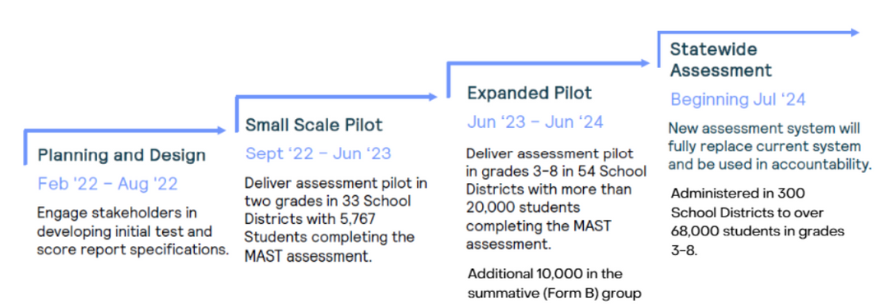
MAST OVERVIEW
6

Slide 7
MATH TESTLET DESIGN
  Each grade has 12 math testlets, each aligned to a strand of mathematical understanding, encompassing a small set of related content standards
  Testlets range from 9-13 items
  Question types include single/multiple choice, numeric text entry, and technology enhanced (matching table, inline choice, etc.)
7

Slide 8
ELA TESTLET DESIGN
  Each grade has 6 ELA testlets: literary and informational content for beginning, middle and end of year with passage-based and standalone syntax and vocabulary items
  Passages complexity increases as the year progresses
  Each testlet has 18 questions
  Question types include single/multiple choice, evidence-based selected response, and technology enhanced (matching table, inline choice, etc.)
8

Slide 9
ELA PERFORMANCE TASK DESIGN
  Administered as the last ELA task in Window 2
  Includes 5 non-scored reading questions from a previous testlet to elicit ideas for writing
  Constructed response performance task in the areas of written expression and knowledge of language and conventions
9

Slide 10
ANCHOR TESTLET
  Administered as the last testlet in Window 3
  Each student receives a pre-assigned math OR ELA testlet
    The ELA form will consist of 16 questions, including standalone and passage-based items.
    The math form will consist of 25 questions. Forms in grades 6-8 are divided into a calculator and non-calculator section.
  The Anchor Testlet plays a critical role in test development, including field testing and psychometric research.
10

Slide 11
MAST OVERVIEW RESOURCES
Theory of Action
Assessment Specifications & Blueprints
  Math
  ELA
Testing Windows
All MAST-related resources can be found
on the MAST Portal
11

Slide 12
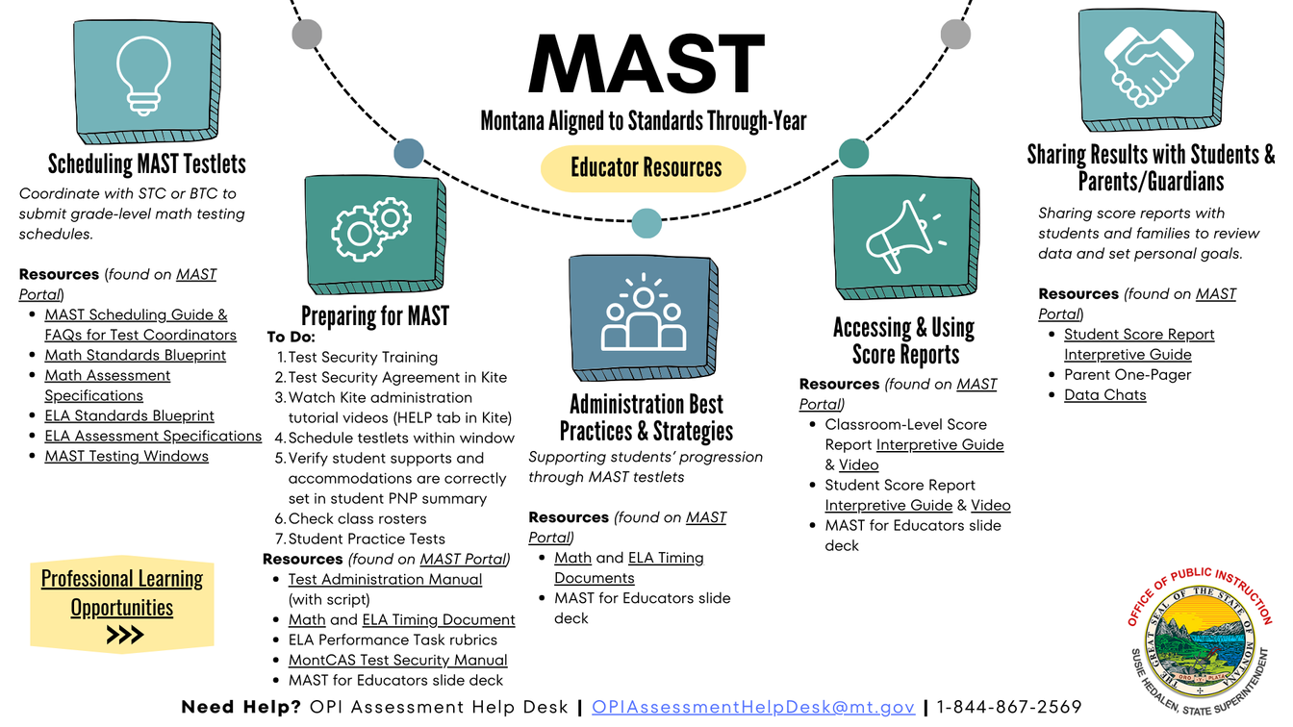
MAST FOR EDUCATORS
Click on the image to access linked resources.
12

Slide 13


MAST TESTING TASKS
The WHY: Successful administration of the MAST.
  Access the Kite Educator Portal
  Complete Test Security Agreement
  Complete Training
  Schedule Testlets
  Verify Student Rosters & PNPs
  Print Student Tickets & DACs
  Administer Practice Tests
  Prepare Students to Test
Before Testing
During Testing
  Administer Testlets
  Monitor Testlet Completion
  Access & Share Student Score Reports
  Access & Share Student Score Reports
  Reflect on the successes and challenges of administration
After Testing
13

Slide 14

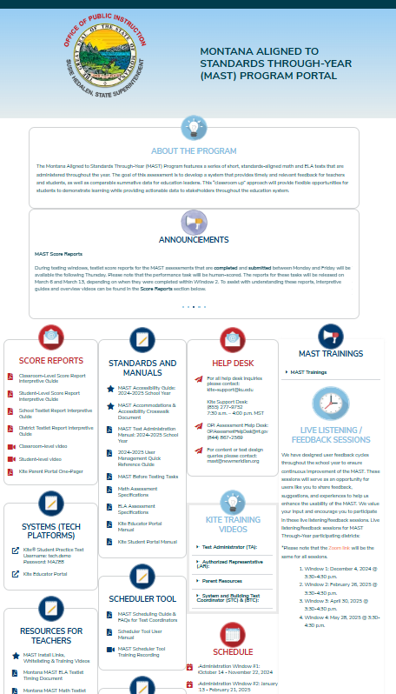
ACCESS THE KITE EDUCATOR PORTAL
Access the Kite Educator Portal through the MAST Portal.
Googling “Kite” and selecting from the search results may bring you to a different state’s portal
Confirm proper access to the Kite Educator Portal
WHY? The Kite Educator Portal is where educators agree to the MAST Test Security Agreement and verify preparations are in place for testing.
Kite Educator Portal
14

Slide 15
ACCESS THE KITE EDUCATOR PORTAL
Things to remember:
  The activation email will be sent to your district registered email address.
  Be sure to check junk/spam in case email is rerouted.
  Be sure to bookmark and use the unique Montana Kite URL:
    https://educator-testlet.kiteaai.org/AART/logIn.htm
  Use your full district email address as the username when logging in.
15

Slide 16
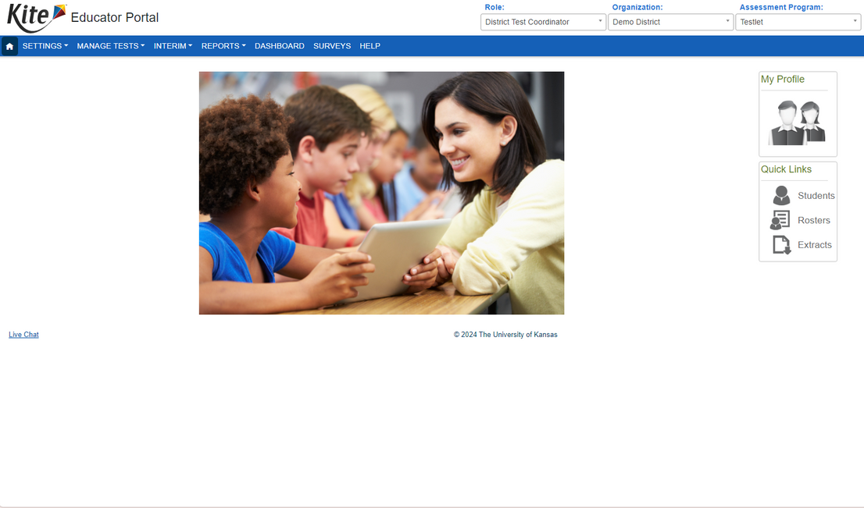
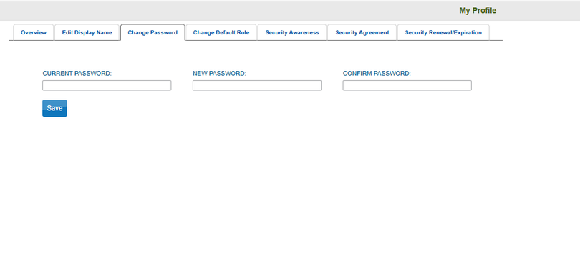

KITE EDUCATOR PORTAL
Kite passwords must be changed every 180 days. An automated email will notify you of the needed change.
Beginning July 25, 2025, Kite Educator Portal will require multifactor authentication as a way to further protect sensitive data and systems. Staff cell phone numbers can be entered so that users can utilize the cell phone option, if desired.
16

Slide 17
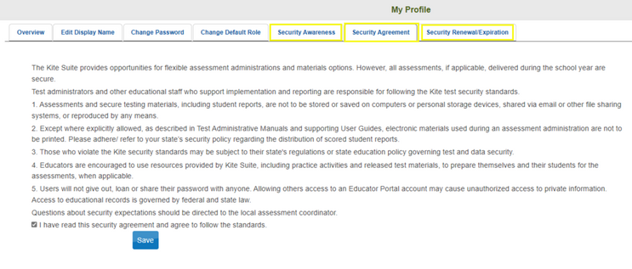
COMPLETE THE TEST SECURITY AGREEMENT
Each year you must agree to the Security Agreement.
It will appear automatically each year.
17

Slide 18
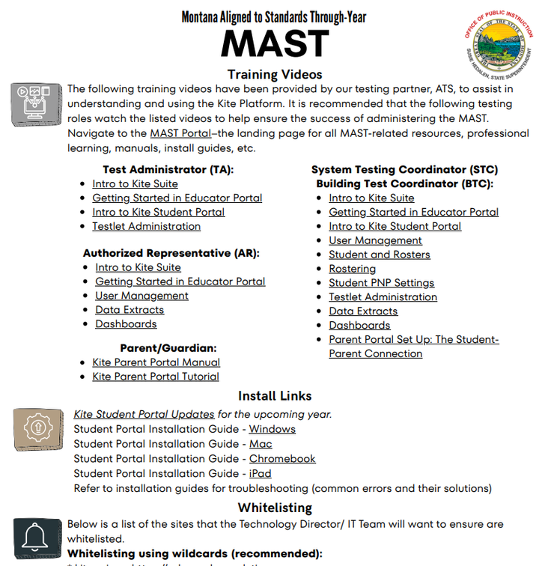
COMPLETE TRAINING
Click on the image to access linked resources.
Tutorials for Test Administrators
18

Slide 19

COMPLETE TRAINING
Test Security Training
All individuals involved in state testing share responsibility for maintaining test security. School systems should ensure that all staff are familiar with their roles and responsibilities before, during, and after testing, as well as throughout the entire testing window.
TA responsibilities include:
• Complete the necessary training and certification requirements.
• Follow the OPI’s policies and procedures for test administration, test accessibility and test security.
• Administer state assessments in accordance with the assessment-specific Test Administration Manuals.
• Report any testing irregularities that occur to the Building Coordinator.
• See Appendix H: TA Roles and Responsibilities for Test Security.
19

Slide 20
COMPLETE TRAINING
Key Information for Test Administration
Follow procedures for materials handling, test administration, test security and accommodations as outlined in the following documents:
  MAST Test Administration Manual
  MontCAS Test Security Manual
  MAST Accessibility Guide
Test materials must be kept secure when not being used for testing
  Test Administrators (TAs) and any trained school staff may not actively view, review, or analyze any secure items from statewide assessments.
  Test materials must not be reproduced (unless directed to do so for specific circumstances or assessments) or in any way released without the written consent of the OPI.
  Test questions may not be shared or discussed.
20

Slide 21
COMPLETE TRAINING
Key Information for Test Administration
In the testing classroom
  What constitutes coaching?
  What constitutes a security breach/serious testing irregularity and how to report it?
  What materials can and cannot be displayed in the testing classrooms?
  Follow the procedures and guidelines outlined in the MAST Accessibility Guide for student accommodations and designated supports.
See MontCAS Test Security Manual for guidance.
21

Slide 22
TRAINING RESOURCES
  Kite Educator Portal (unique MT login)
  Kite Educator Portal Manual
  Kite Educator Portal Multifactor Authentication
  MAST Test Administration Manual
  MAST Training Videos
  Test Administrator Roles and Responsibilities for Test Security
  MontCAS Test Security Manual
All MAST-related resources can be found
on the MAST Portal
22

Slide 23
MAST TESTING TASKS
The WHY: Successful administration of the MAST.
  Access the Kite Educator Portal
  Complete Test Security Agreement
  Complete Training
  Schedule Testlets
  Verify Student Rosters & PNPs
  Print Student Tickets & DACs
  Administer Practice Tests
  Prepare Students to Test
Before Testing
During Testing
  Administer Testlets
  Monitor Testlet Completion
  Access & Share Student Score Reports
  Access & Share Student Score Reports
  Reflect on the successes and challenges of administration
After Testing
23

Slide 24

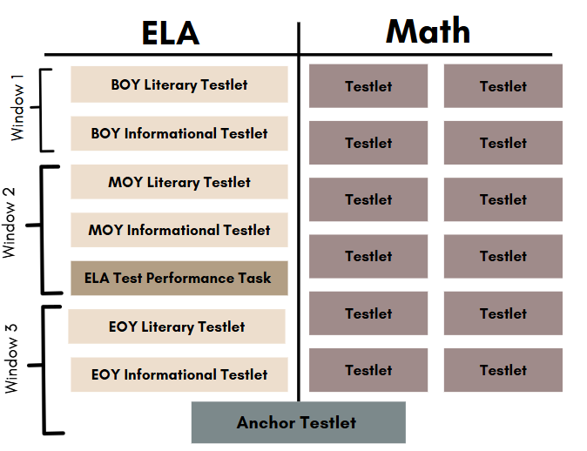
SCHEDULE TESTLETS
2025-2026 MAST Test Design
These 12 testlets are flexibly scheduled at the school level
24

Slide 25
SCHEDULE TESTLETS
2025-2026 Testing Overview
 | Window 1 | Window 2 | Window 3
 | October 13 - December 5 | January 12 - March 6 | March 30 - May 22
 | 8 weeks | 8 weeks | 8 weeks
MATH | 3-5 Testlets | 3-5 Testlets | 3-5 Testlets
MATH | 3-5 Testlets | 3-5 Testlets | 1 Anchor Test
ELA | 2 BOY Testlets | 2 MOY Testlets Performance Task | 1 Anchor Test
ELA | 2 BOY Testlets | 2 MOY Testlets Performance Task | 2 EOY Testlets
All 12 testlets must be scheduled and administered across the 3 testing windows
25

Slide 26

SCHEDULE TESTLETS
Tools for Scheduling Testlets
  Math pacing guides & school calendar
  Previous year’s MAST math testlet schedule
  Previous or upcoming year’s high-level lesson plans
  Any notes from the previous year’s pacing
  MAST Math Assessment Specifications & Blueprint
  MAST Scheduling Guide & FAQs for Test Coordinators
Compare your math curriculum units, standards, and pacing to the testing windows and to the math test blueprints to determine which testlets should be administered during each window.
Use the Math Schedule Worksheet to share with your District System Test Coordinator.
26

Slide 27

SCHEDULE TESTLETS
Beginning of School Year Discussions for Scheduling
  Is there a curriculum change for the upcoming school year?
  How well did math testlets align to instruction last year?
    Were there testlets that could have been administered earlier?
    Were there testlets that should have been moved to a later window?
  How will the move from six to eight week windows affect our scheduling?
27

Slide 28
SCHEDULE TESTLETS
Schedule Testlets Within Testing Windows
Best Practice Considerations
  Before testing: Collaborate with school and/or district for scheduling
  Administer as close to instruction as possible (at the end of the unit/chapter)
  Spread out testing throughout the window rather than clustering all testlets into the same week
  Plan for make ups
28

Slide 29

MAKE UP TESTING
Considerations for Make-Up Testing
  Plan for make-ups: We know students will be absent during testlets.
  Make-ups can occur in the classroom. Is there a time when the rest of the class is working quietly and a student could complete a testlet?
Remember: Students do not have to leave the classroom for makeups.
29
Notes:
Summative Mindset***

Slide 30
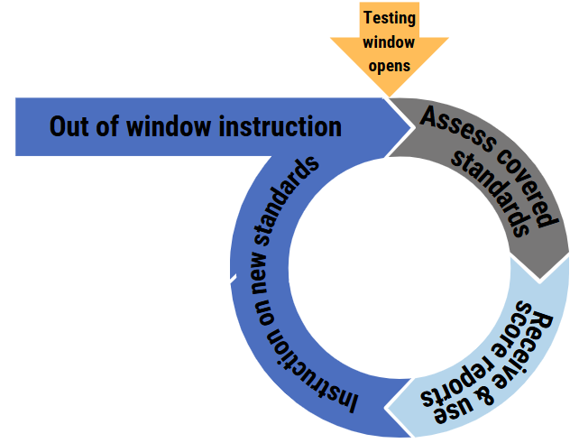


SCHEDULE TESTLETS
Schedule Testlets Within Testing Windows
Think about how this cycle works.
Could your schedule better reflect this cycle?
30

Slide 31
DATA VS. PRACTICE
Math Average Timing | Math Average Timing | Math Average Timing | Math Average Timing
 | p50 | p80 | p90
Grade 3 | 9.5 | 15.6 | 20.8
Grade 4 | 11.9 | 19.4 | 26.2
Grade 5 | 10.4 | 16.6 | 21.9
Grade 6 | 11.0 | 16.5 | 20.8
Grade 7 | 12.1 | 18.0 | 22.2
Grade 8 | 10.2 | 15.3 | 19.0
What are causing administration times higher than the actual testing times?
 | MOY Informational | MOY Informational | MOY Informational | MOY Literary | MOY Literary | MOY Literary | Performance Task | Performance Task | Performance Task
 | p50 | p80 | p90 | p50 | p80 | p90 | p50 | p80 | p90
Grade 3 | 18 | 27.2 | 34.6 | 18.7 | 27.6 | 35.5 | 6 | 12.3 | 17.6
Grade 4 | 20.3 | 30.1 | 38.7 | 20.6 | 30 | 38.6 | 5.7 | 11.7 | 16.6
Grade 5 | 20.8 | 30.6 | 38.4 | 20.4 | 28.7 | 35.4 | 6.7 | 13.6 | 18.2
Grade 6 | 18.7 | 26.4 | 31.8 | 18.4 | 25.9 | 31.6 | 6.1 | 11.6 | 15.2
Grade 7 | 19.6 | 26.6 | 31.7 | 17.5 | 24 | 28.4 | 6.1 | 11.4 | 14.4
Grade 8 | 17 | 24 | 28.5 | 13.9 | 18.8 | 22.5 | 4.7 | 9 | 12.1
31
Notes:
chrome-extension://efaidnbmnnnibpcajpcglclefindmkaj/https://nationalp-3center.org/wp-content/uploads/2021/03/Executive-Summary_NAESP_Pre-K%E2%80%933rd-Grade.pdf

Slide 32
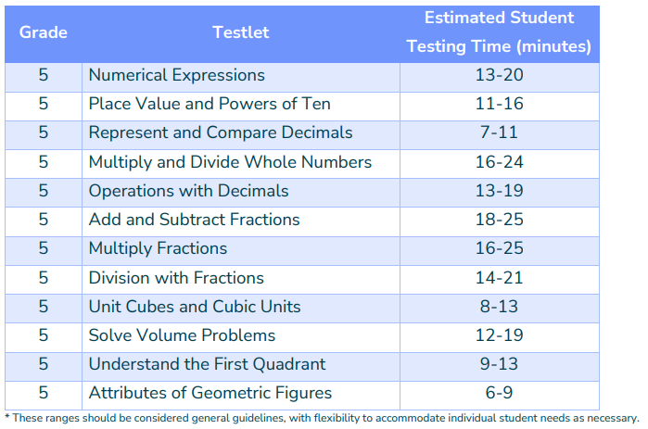
SCHEDULE TESTLETS
Scheduling to Support Instruction
How can this information help minimize lost instructional time due to administration?
32

Slide 33
REFLECT
Beginning of the Year
  How will you make note of testlets that could be moved to earlier or later windows?
  How will testing closer to instruction build student success versus testing all at once?
  How will you use the timing documents in scheduling testlets?
  How will you plan for make-ups throughout the window to ensure timely completion?
33

Slide 34
SCHEDULING RESOURCES
  MAST Math Scheduling Worksheet
  Math Assessment Specifications
  Math Standards Blueprint
  ELA Assessment Specifications
  ELA Standards Blueprint
  Math and ELA Timing Documents
  Testing Windows
All MAST-related resources can be found
on the MAST Portal
34

Slide 35
MAST TESTING TASKS
The WHY: Successful administration of the MAST.
  Access the Kite Educator Portal
  Complete Test Security Agreement
  Complete Training
  Schedule Testlets
  Verify Student Rosters & PNPs
  Print Student Tickets & DACs
  Administer Practice Tests
  Prepare Students to Test
Before Testing
During Testing
  Administer Testlets
  Monitor Testlet Completion
  Access & Share Student Score Reports
  Access & Share Student Score Reports
  Reflect on the successes and challenges of administration
After Testing
35

Slide 36
VERIFY STUDENT ROSTERS & PNPS
What is a roster?
  A roster connects students to teachers that will have access to their testlet and score reports.
  WHY is this important? Rostering is essential for proper test assignment, monitoring, and teacher access to student score reports.
Who can set rosters?
  District and building level users have the ability to assign students to teachers creating rosters.
  If your rosters are not correct, please reach out to a building or district-level user.
36

Slide 37
VERIFY STUDENT ROSTERS & PNPS
What is a PNP?
  A student’s PNP or Personal Needs Profile sets additional supports during testing within the Kite system.
  WHY are PNPs important? To obtain valid and reliable test results, accommodations and designated supports should reflect student need and daily learning environment.
What students should have PNP settings?
  Students with statewide assessment accommodations within active 504/IEPs or use designated supports in daily learning experiences.
Who can set PNPs?
  District and building level users have the ability to set PNPs. Teachers are able to view PNPs.
  If your students’ PNPs are not correctly set, please reach out to a building or district-level user prior to administration.
37

Slide 38
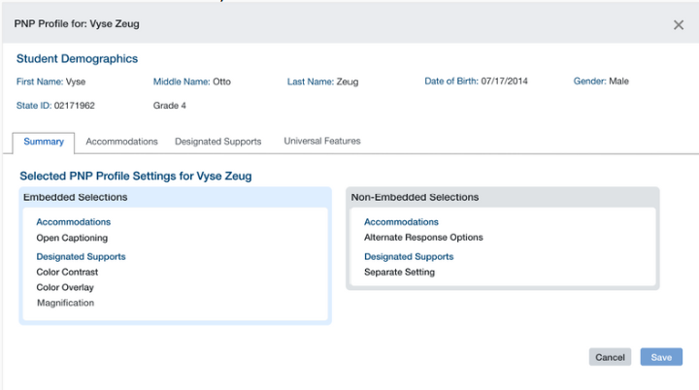
VERIFY STUDENT ROSTERS & PNPS
Reviewing Student PNPs
*viewable by all users with student connection
38

Slide 39
VERIFY STUDENT ROSTERS & PNPS
MAST Assessment Supports
Accessibility Feature | Embedded | Non-Embedded
Universal Tools | Calculator (6-8 testlet specific), highlighter, notes, striker | Breaks, scratch paper
Designated Supports | Color overlay, answer masking, spoken audio (math) | Noise buffers, medical supports, separate setting
Accommodations | Speech to Text (ELA Passages), signed items (ASL) | Braille forms, scribe, paper form
39

Slide 40

VERIFY STUDENT ROSTERS & PNPS
Considerations for Supports
  Accommodations must be included in a student’s IEP/504 plan to be set in Kite.
  Any supports or accommodations should mirror the regular learning and testing environment for the student. MAST testing shouldn’t feel different.
40

Slide 41
VERIFY STUDENT ROSTERS & PNPS
If a student begins to test and PNPs are not showing up, STOP testing.
Contact your building or district testing coordinator immediately and ensure supports are correct before resuming.
41

Slide 42
VERIFY ROSTERS & PNPS RESOURCES
  MAST Accessibility Guide
  MAST Test Administration Manual
  Montana’s Three Tiers of Accessibility
  English Learner Guidance for School Districts
All MAST-related resources can be found
on the MAST Portal
42

Slide 43
MAST TESTING TASKS
The WHY: Successful administration of the MAST.
  Access the Kite Educator Portal
  Complete Test Security Agreement
  Complete Training
  Schedule Testlets
  Verify Student Rosters & PNPs
  Print Student Tickets & DACs
  Prepare Students to Test
Before Testing
During Testing
  Administer Testlets
  Monitor Testlet Completion
  Access & Share Student Score Reports
  Access & Share Student Score Reports
  Reflect on the successes and challenges of administration
After Testing
43

Slide 44
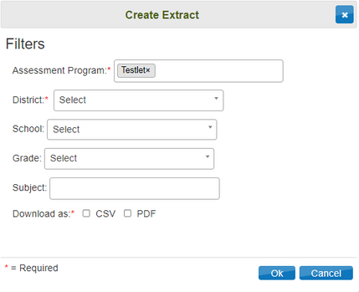
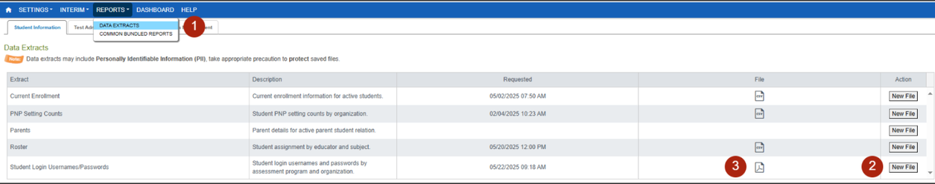
PRINT STUDENT TICKETS AND DACS
Printing Test Tickets
DATA EXTRACT METHOD
Navigate to:
  REPORTS > DATA EXTRACTS
  Click on New File in the Student Login Usernames/Passwords row.
  Fill out organization drop-downs in the Create Extract pop-up window then choose OK.
  Once the report is generated, click on the PDF icon to download to your device.
44

Slide 45

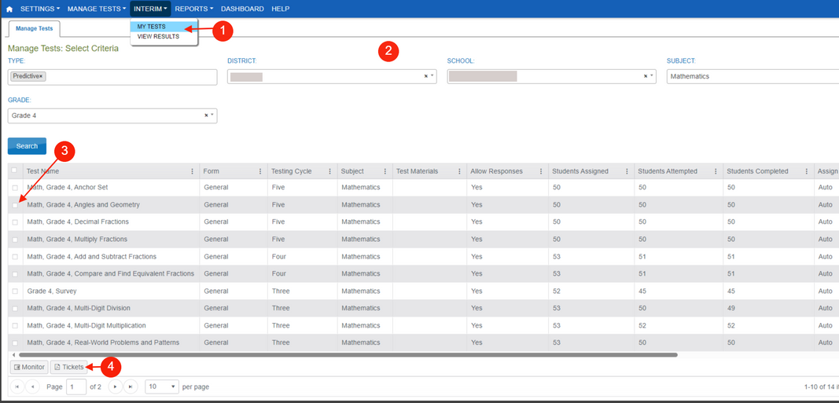
PRINT STUDENT TICKETS AND DACS
Printing Test Tickets
TEST MONITOR SCREEN METHOD
Not available until in an open testing window, and tickets become unavailable after the student has completed that specific testlet.
Navigate to:
  INTERIM > MY TESTS
  Fill out the organization drop-downs.
  Select the testlet for which you want to print student test tickets.
  Click on Tickets button.
Student login credentials remain the same throughout the school year.
45

Slide 46
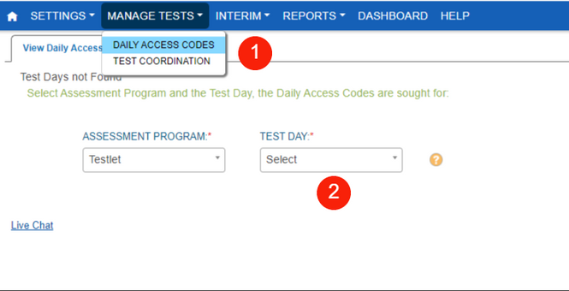
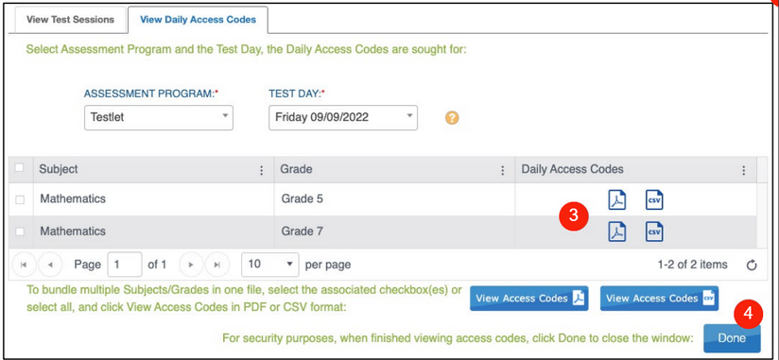
PRINT STUDENT TICKETS AND DACS
Daily Access Codes
Navigate to:
  MANAGE TESTS > DAILY ACCESS CODES
  Select the Test Day
  In the Daily Access Codes column, select either the PDF or CSV icon to open the file.
  Select Done once you have finished viewing the Daily Access Codes grid.
46

Slide 47
PRINT STUDENT TICKETS AND DACS RESOURCES
  Kite Educator Portal Manual
  MAST Test Administration Manual
All MAST-related resources can be found
on the MAST Portal
47

Slide 48
MAST TESTING TASKS
The WHY: Successful administration of the MAST.
  Access the Kite Educator Portal
  Complete Test Security Agreement
  Complete Training
  Schedule Testlets
  Verify Student Rosters & PNPs
  Print Student Tickets & DACs
  Prepare Students to Test
Before Testing
During Testing
  Administer Testlets
  Monitor Testlet Completion
  Access & Share Student Score Reports
  Access & Share Student Score Reports
  Reflect on the successes and challenges of administration
After Testing
48

Slide 49
PREPARE STUDENTS TO TEST
What are some ways you currently prepare students for assessments?
49

Slide 50

PREPARE STUDENTS TO TEST
Consider
  Inviting students into goal setting: Encourage student agency about their learning. Where are they going...what are the steps to get there.
  Developing a growth mindset with your students: Smart is not something you are born with...it is something you CAN be!
50

Slide 51
PREPARE STUDENTS TO TEST
Have you....
  Let students know the purpose of the assessment
  Used practice tests to familiarize students with the format and how to use tools: e.g. Review questions before reading comprehension passages, highlighting key words, blocking out answers they rule out, how to come back to questions they want to review
  Projected the practice tests on your whiteboard and work through examples with the whole class or in small groups
  Used the rubrics found on MAST portal to prepare students for the writing Performance Task
51

Slide 52
PREPARE STUDENTS TO TEST
Testlets should not be a surprise to students: either in content or format.
52

Slide 53
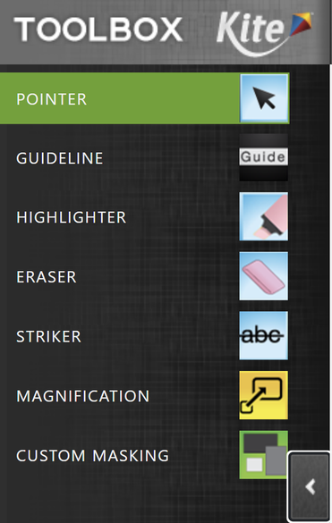
PREPARE STUDENTS TO TEST
Toolbox Available in Kite
How can these tools help students during the assessment?
53

Slide 54
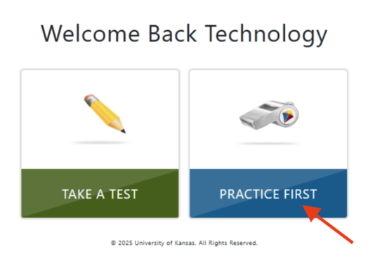
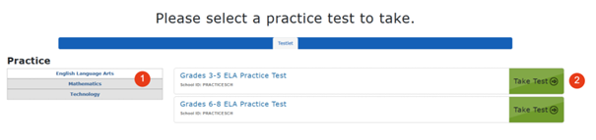
PREPARE STUDENTS TO TEST
Practice Tests
https://student-testlet.kiteaai.org/
username: tech.demo
password: MAZE8
Click on Practice First.
  Choose ELA or Math.
  Select the grade band then Take Test.
54

Slide 55
PREPARE STUDENTS TO TEST
How to help students not get “bogged” down with a question:
(Script that you can use)
“Class, let’s review some tips for working through (math, ELA) testlets. Remember:
1.) If you know the answer, mark your choice
2.) Can you answer the question in a couple of minutes? Then go ahead and figure it out
3.) Do you not know how to answer the question? Mark your best answer and move on. You can come back at the end and review.”
Sitting and staring at something for a longer and longer time does not help a student answer correctly!
55

Slide 56
PREPARE STUDENTS TO TEST RESOURCES
  Kite Practice Test
    Username: tech.demo
    Password: MAZE8
  Kite Student Portal Manual
All MAST-related resources can be found
on the MAST Portal
56

Slide 57
MAST TESTING TASKS
The WHY: Successful administration of the MAST.
  Access the Kite Educator Portal
  Complete Test Security Agreement
  Complete Training
  Schedule Testlets
  Verify Student Rosters & PNPs
  Print Student Tickets & DACs
  Prepare Students to Test
Before Testing
  Administer Testlets
  Monitor Testlet Completion
  Access & Share Student Score Reports
During Testing
  Access & Share Student Score Reports
  Reflect on the successes and challenges of administration
After Testing
57

Slide 58
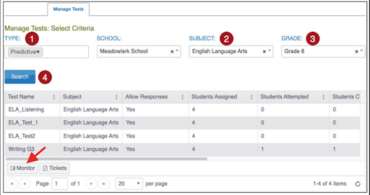
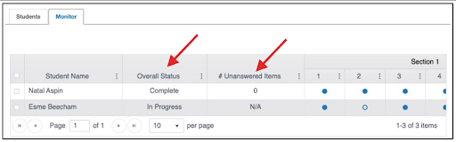

ADMINISTER TESTLETS
Navigate to:
  INTERIM > My Tests
  Fill out organizational information in drop down menus.
  Click Search.
Materials Needed:
  Print student test tickets (username/password)
  Print Daily Access Codes (DACs)
  Test Administration script
During Administration:
  Test administrators can view individual student progress status, number of unanswered questions, and progress through testlet.
  Test administrators can pause/resume testlets.
  Students must Submit testlets to get score report results.
58

Slide 59
ADMINISTER TESTLETS
What are some ways you currently monitor during assessments?
59

Slide 60
ADMINISTER TESTLETS
Monitoring During Test Administration
  Setting time boundaries
  Ensuring students are completing testlets in a timely manner and submitting testlets for scoring
60

Slide 61
ADMINISTER TESTLETS
Consider
Setting time boundaries for MAST by:
  Checking the timing documents and letting students know how much time they will have (untimed does not have to mean unlimited)
  Teaching for the first part of the period and then assessing at the end helps establish a natural time boundary
61

Slide 62

ADMINISTER TESTLETS
Consider
  Actively monitoring: Walking around and checking student progress helps with students taking too long. Try: “I notice you have been on this number awhile. Let’s try moving on and coming back to it at the end”
  Encouraging students who may be rushing to slow down a bit
  Having students raise their hands when they are finished before they submit their assessment. You can use this as an opportunity to have a student go back and review if he/she rushed.
62

Slide 63
ADMINISTER TESTLETS RESOURCES
  Test Administration Tutorial Video
  Kite Educator Portal Manual
  MAST Test Administration Manual
  Test Administration Focused Support Video on the MAST Stay Informed webpage.
All MAST-related resources can be found
on the MAST Portal
63

Slide 64
MAST TESTING TASKS
The WHY: Successful administration of the MAST.
  Access the Kite Educator Portal
  Complete Test Security Agreement
  Complete Training
  Schedule Testlets
  Verify Student Rosters & PNPs
  Print Student Tickets & DACs
  Prepare Students to Test
Before Testing
  Administer Testlets
  Monitor Testlet Completion
  Access & Share Student Score Reports
During Testing
  Access & Share Student Score Reports
  Reflect on the successes and challenges of administration
After Testing
64

Slide 65
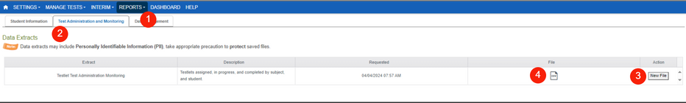
MONITOR TESTLET COMPLETION
Using a Data Extract
This method is the most efficient and effective method to find individual students and testlets needing to be completed.
Navigate to:
  REPORTS > DATA EXTRACTS
  Select the Test Administration and Monitoring tab.
  Click on New File.
  Once the file has loaded, click on the csv icon to download a document that can be filtered to identify testlets that in progress, unused, or paused.
Filtering must be performed to generate a list of students and names of testlets left to complete. Use this short video to learn how to filter the data extract.
65

Slide 66
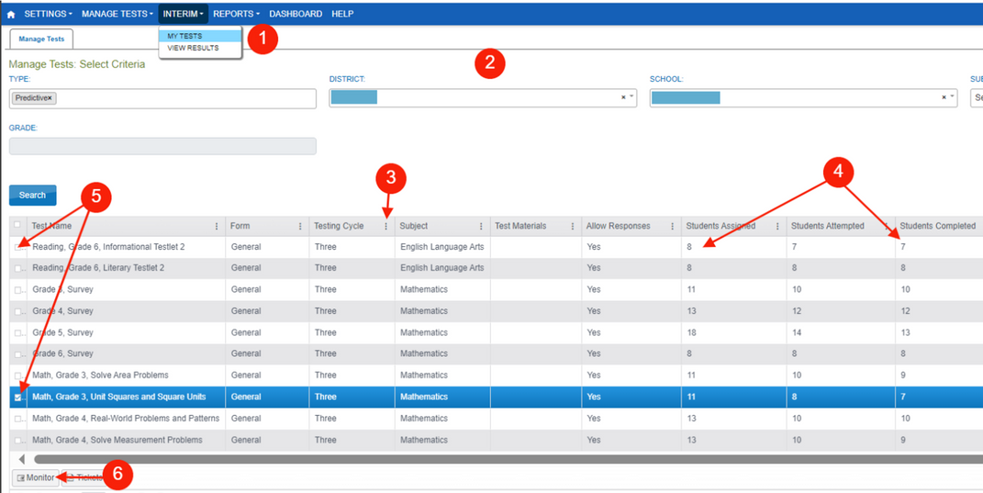
MONITOR TESTLET COMPLETION
Using the Test Monitor Screen
Testlet completion can also be monitored by grade level and testlet using filtering options in the INTERIM > My Tests section of the Kite Educator Portal.
  INTERIM > My Tests
  Fill out organizational information in the drop-down menus.
  Select the three dots to filter to see the appropriate testing window.
  Compare “Students Completed” to “Students Assigned”.
  Select the testlets that are not completed. Multiple testlets can be monitored. You can select up to 4.
  Select Monitor button.
66

Slide 67
MONITOR TESTLET COMPLETION
Considerations
  Plan for make-ups: We know students will be absent during testlets.
  Make-ups can occur in the classroom. Is there a time when the rest of the class is working quietly and a student could complete a testlet?
Remember: Students do not have to leave the classroom for makeups.
67

Slide 68
MONITOR TESTLET COMPLETION
  Kite Educator Portal Manual
  Filtering the Data Extract Tutorial
  Monitor Testlet Completion Focused Support Video on the MAST Stay Informed webpage.
All MAST-related resources can be found
on the MAST Portal
68

Slide 69
MAST TESTING TASKS
The WHY: Successful administration of the MAST.
  Access the Kite Educator Portal
  Complete Test Security Agreement
  Complete Training
  Schedule Testlets
  Verify Student Rosters & PNPs
  Print Student Tickets & DACs
  Prepare Students to Test
Before Testing
  Administer Testlets
  Monitor Testlet Completion
During Testing
  Access & Share Student Score Reports
  Reflect on the successes and challenges of administration
After Testing
69

Slide 70

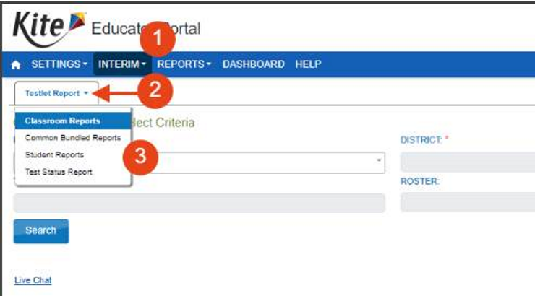
ACCESS & SHARE SCORE REPORTS
Navigate to:
  INTERIM > VIEW RESULTS.
  Click on the dropdown menu for Testlet Report.
  Classroom Reports is the default. Individual student reports and bundling options are available in the dropdown. Fill organization fields then select Search.
  Student score reports are available weekly during testing windows.
  ELA performance tasks are hand-scored. Reports will become available after the window.
70

Slide 71
ACCESS & SHARE SCORE REPORTS
Testlet Reports | Summative Reports
Student Testlet Report Available weekly Available in Parent Report as well | Student Summative Report 24-25 reports available in October 25-26 reports available after last operational window
Classroom Testlet Report Available Weekly | Classroom Summative Report 24-25 reports available in October 25-26 reports available after last operational window
School Testlet Report Available after each operational window | School Summative Report 24-25 reports available in October 25-26 reports available after last operational window
District Testlet Report Available after each operational window | District Summative Report 24-25 reports available in October 25-26 reports available after last operational window
71

Slide 72
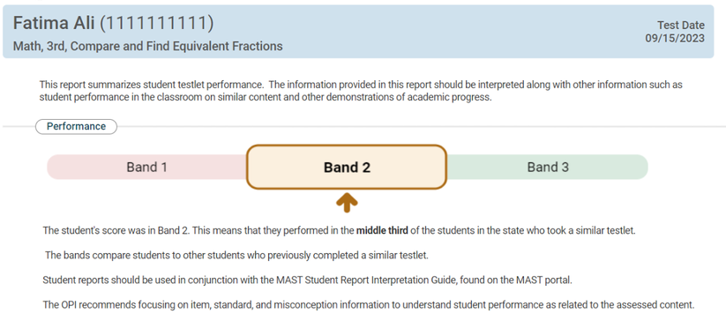
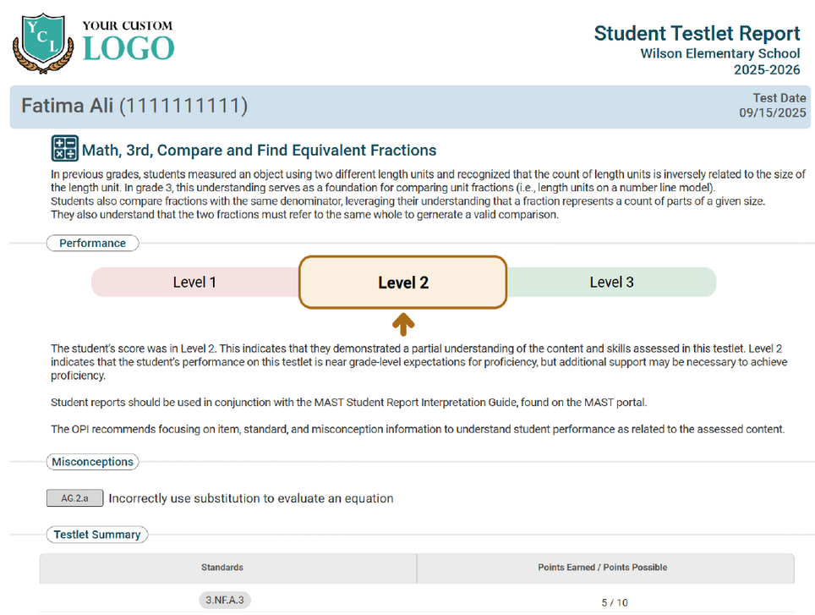
INTERPRETATION OF REPORTS
2024-2025 Reports - Performance BANDS - Norm Referenced
2025--2026 Reports - Performance LEVELS - Criterion Referenced
Performance aligns with overall performance, not specifically as it relates to proficiency on the standards assessed.
72

Slide 73

STUDENT TESTLET REPORTS - MATH
Performance aligns with overall performance, not specifically as it relates to proficiency on the standards assessed.
73

Slide 74
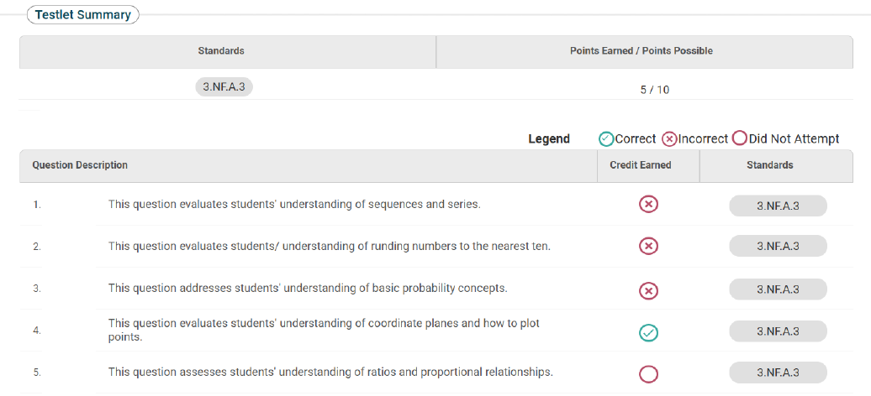
STUDENT TESTLET REPORTS - MATH
student math score report image
74

Slide 75
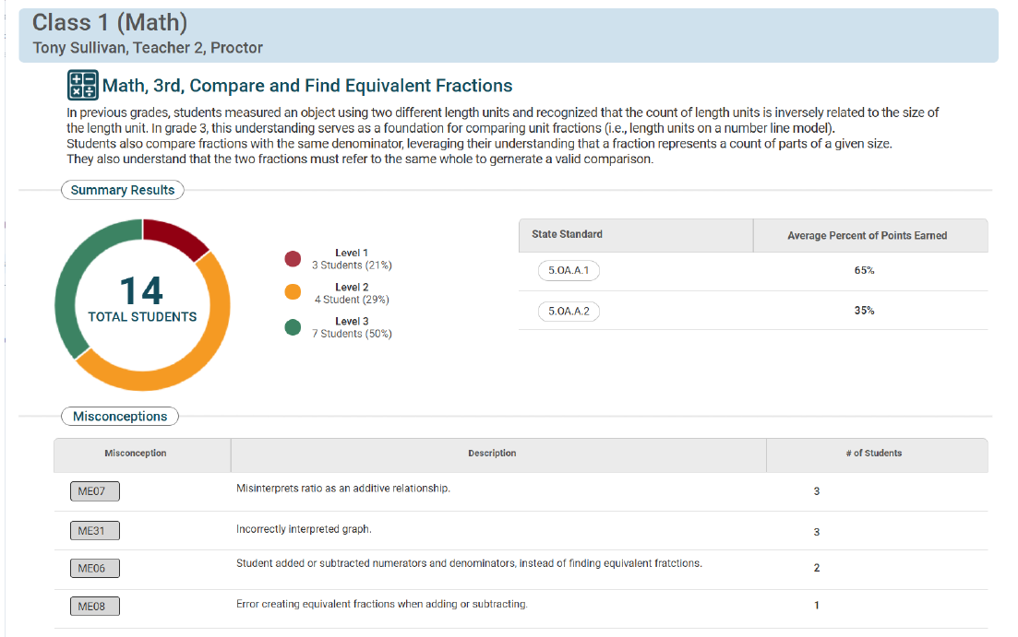
CLASSROOM TESTLET REPORTS - MATH
75

Slide 76
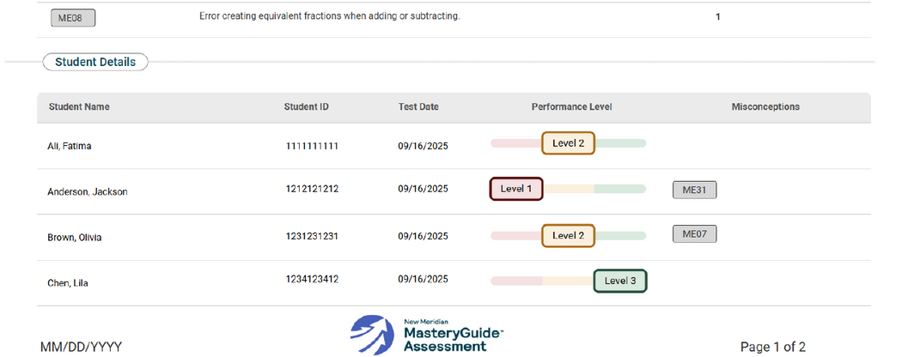
CLASSROOM TESTLET REPORTS - MATH
76

Slide 77
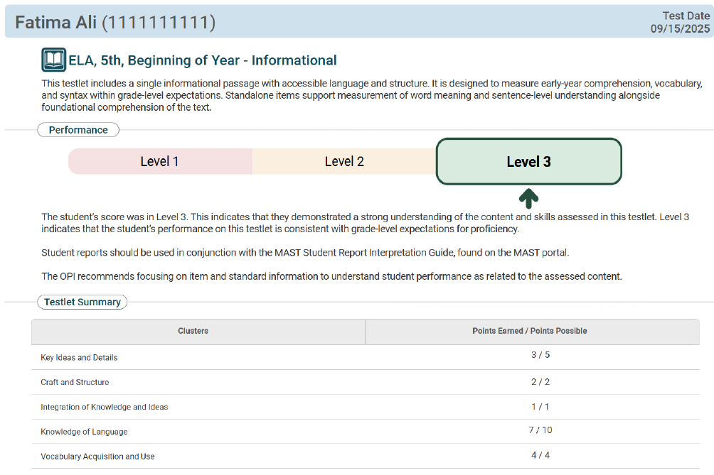
STUDENT TESTLET REPORTS - ELA
77
Notes:
Aimee

Slide 78
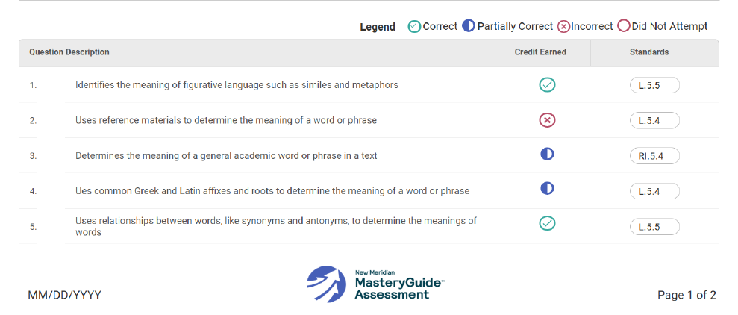
STUDENT TESTLET REPORTS - ELA
78
Notes:
Aimee

Slide 79
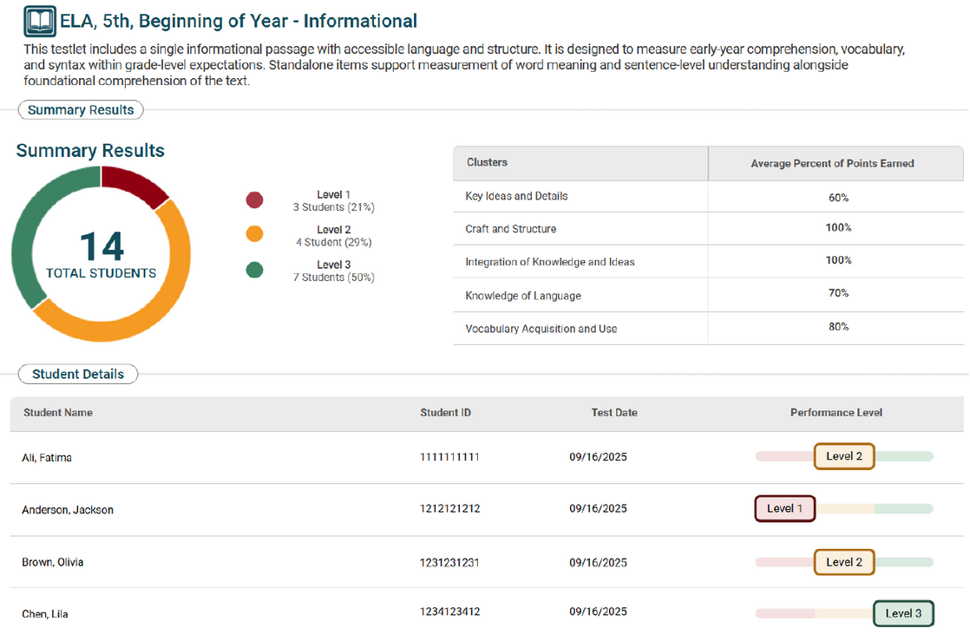
CLASSROOM TESTLET REPORTS - ELA
79
Notes:
Aimee

Slide 80
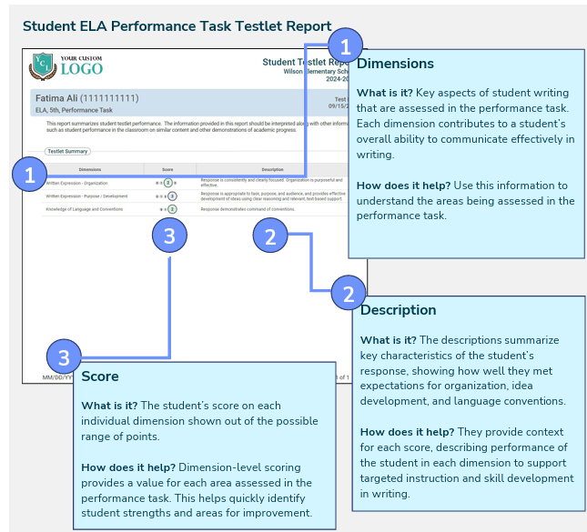
PERFORMANCE TASK REPORTS - ELA
80

Slide 81
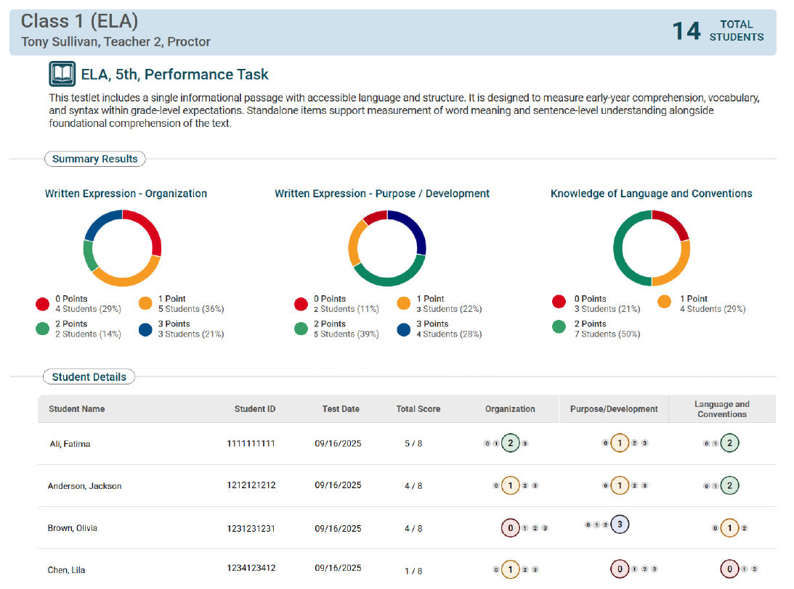
PERFORMANCE TASK REPORTS - ELA
81

Slide 82

ACCESS & SHARE SCORE REPORTS
What do you currently do to share results with students and help them with reflection and goal setting?
82

Slide 83

ACCESS & SHARE SCORE REPORTS
Reflection
Are my scores consistent with expectations?
What misunderstandings are revealed?
Were there gaps in instruction that contributed to misunderstandings?
What can I do to help students master this standard?
83

Slide 84
ACCESS & SHARE SCORE REPORTS
Helping students make sense of their data
What conversations with students happened at the grade level/classroom level with traditional summative (SBAC) score reports?
What conversations can we have now with MAST testlet score reports?
How can this help students throughout the year?
84

Slide 85
ACCESS & SHARE SCORE REPORTS
Data Chats
When students engage with teachers around their data and participate in setting personal goals, they feel empowered in their learning. It lays the groundwork for a strong commitment to student achievement and success.
We have a unique opportunity with our MAST assessment results being delivered in a timely manner to share data with students throughout the year.
85

Slide 86
ACCESS & SHARE SCORE REPORTS
Principles to keep in mind
  Encourage students to take ownership over their goals and next steps by setting a positive tone, pausing to let them reflect, and helping them brainstorm ideas.
  Focus on each student’s individual performance and goals. Avoid making comparisons to peers.
86

Slide 87
ACCESS & SHARE SCORE REPORTS
1:1 Data Chats
  Share a copy of score report(s) with student
  Explain the assessment and the report
  Keep the conversation grounded in data, but provide context. E.g.,“We are looking at your data so we can help you learn.”
Some questions you can ask:
  What makes you proud about your score?
  What would you like to improve?
  How will you achieve that goal? (Provide some examples of ways to improve if students have trouble coming up with ideas.)
  What can you keep doing, or change for next time?
87

Slide 88
ACCESS & SHARE SCORE REPORTS
1:1 Data Chats
What are some areas that you can improve upon? What are some areas that need more attention or focus? What could you do differently?
What specific and concrete actions can you do?
How can you advocate for yourself? In other words, how can your teacher, your peers, or others guide you toward your goal?
88

Slide 89
ACCESS & SHARE SCORE REPORTS
Whole Class Data Chats:
To prepare for whole class:
  Have demo score report ready to share and explain
  Have student reports ready for students
  Explain that students should focus on their own data and not share their data with other classmates.
89

Slide 90
DATA CHATS
  Let’s take a look at your data.
  Here is a sample score report on the screen.
  You have your student score report in front of you
90

Slide 91
DATA CHATS
Using your reflection sheet, let’s think about some questions:
  What did you do well on this testlet?
  What would you like to improve?
  What can you keep doing, or change for next time?
  How will you achieve that goal?
Some ideas: Ask questions in class, Take more time on the assessment
91

Slide 92
ACCESS & SHARE SCORE REPORTS
Sharing Data with Families
Why do individual student testlet score reports need to be distributed to families?
Sharing student score reports with parents/guardians helps support student learning and success in the classroom. It’s important to help parents and families understand data and encourage them to talk with their student about strengths and areas of growth.
92

Slide 93
ACCESS & SHARE SCORE REPORTS
METHODS TO DISTRIBUTE INDIVIDUAL SCORE REPORTS TO FAMILIES
  Hard copy delivery: Printing and distributing to parents/guardians in a way that works best for your district (i.e. mailing, parent/teacher conferences, etc.).
  The Kite Parent Portal: Districts make the student-parent connection in the Kite Educator Portal then share information to parents/guardians on how to access in the Parent Portal. Parents/guardians will have access to the student testlet-level score report on completed testlets within testing windows when reports release weekly.
  Individual student testlet results should be shared with parents/guardians in a timely manner.
  The individual student summative through-year report should be placed in student permanent files and shared with parents/guardians in a timely manner.
93

Slide 94
DATA CHATS WITH FAMILIES
Some ideas for data chats with families:
  Ensure your discussion is part of a broader discussion: “This MAST score report is one way to help us understand your student’s progress”
  Have a copy of the student score report(s)
  Explain the report (Interpretive Guides are available on MAST portal page)
  Keep the discussion grounded in data and the why: “We are looking at your student’s data to identify next steps”
  Emphasize the specifics from the report: Show areas the student is mastering or struggling with
  Avoid making comparisons to peers
  Discuss goals for the student (could be goals that student established in your student data chat)
  Suggest ways a family could help at home: completing homework, asking for help when needed, support a growth mindset
94

Slide 95
ACCESS & SHARE SCORE REPORTS RESOURCES
  Data Chats
  Student Score Report Interpretive Guide and Video
  Classroom Report Interpretive Guide and Video
  Parent One-Pager
All MAST-related resources can be found
on the MAST Portal
95

Slide 96
MAST TESTING TASKS
The WHY: Successful administration of the MAST.
  Access the Kite Educator Portal
  Complete Test Security Agreement
  Complete Training
  Schedule Testlets
  Verify Student Rosters & PNPs
  Print Student Tickets & DACs
  Prepare Students to Test
Before Testing
  Administer Testlets
  Monitor Testlet Completion
During Testing
  Access & Share Student Score Reports
  Reflect on the successes and challenges of administration
After Testing
96

Slide 97
REFLECT: BEGINNING OF YEAR
What are some successes you anticipate with MAST administration this year?
How will you plan for data chats with your students?
What challenges might you experience?
97

Slide 98
REFLECT: MIDDLE OR END OF YEAR
What are some successes you had with MAST administration this year?
How did data chats go with students?
How were you able to utilize score reports in your instruction?
What challenges did you experience?
What changes might you make based on these challenges?
98

